Slide 1
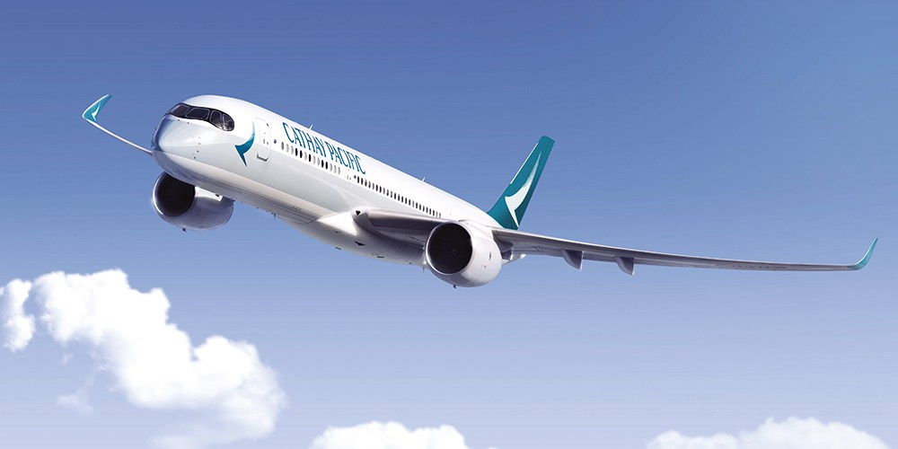
How can Cathay Pacific leverage technology to create a “Life Well Travelled” experience to Millennials?
Studio CX –
Food and Beverage Function
Team 5

Slide 2
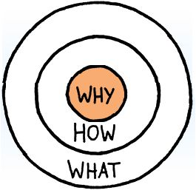




Personal Touch
Tech Savvy

Slide 3
Benefits

Slide 4
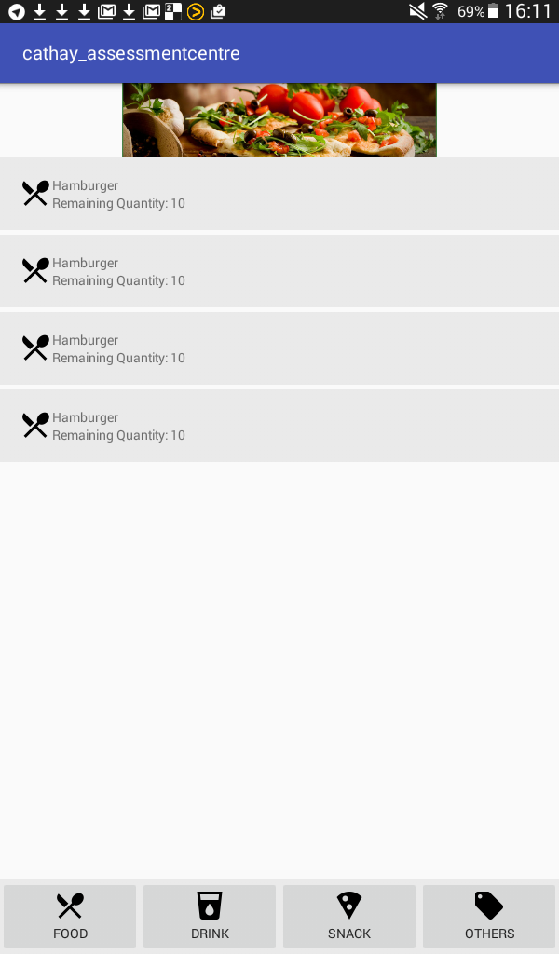
Customer’s View
1. Go through the catalogue to order food
Tabs to select Food / Drink / Snack/ Others

Slide 5
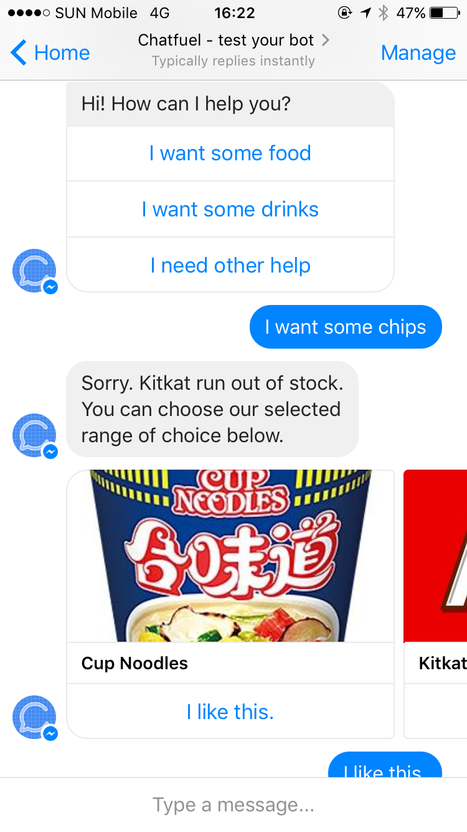
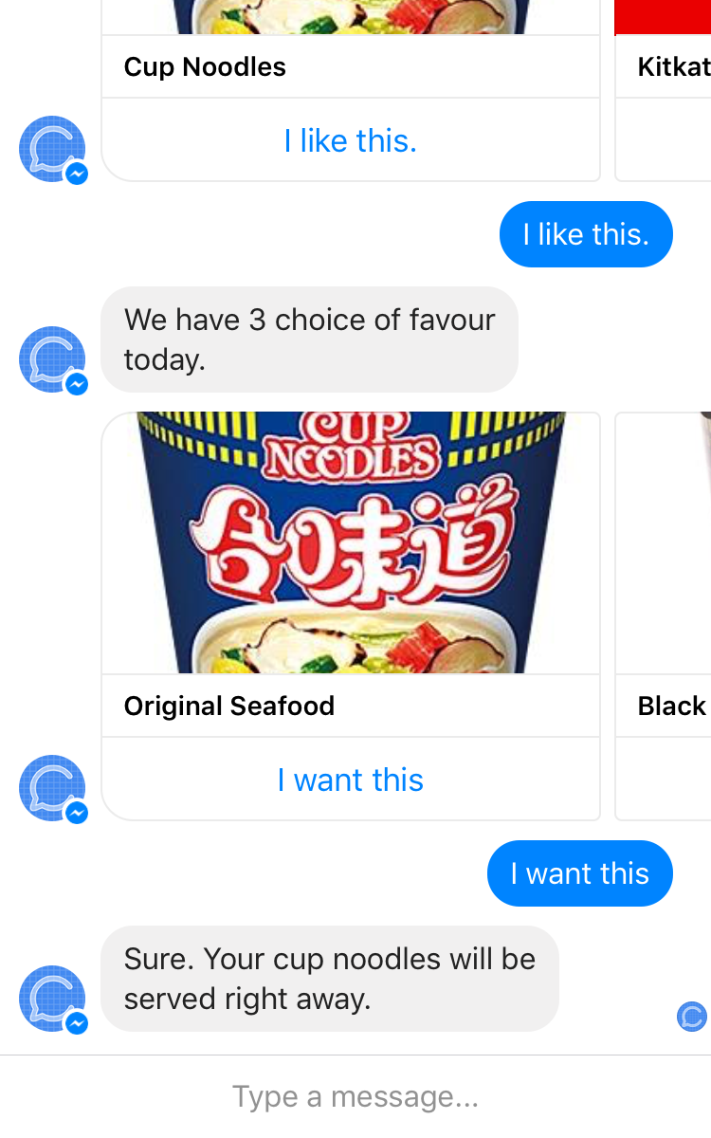
Customer’s View
2. Use chatbot to order food

Slide 6
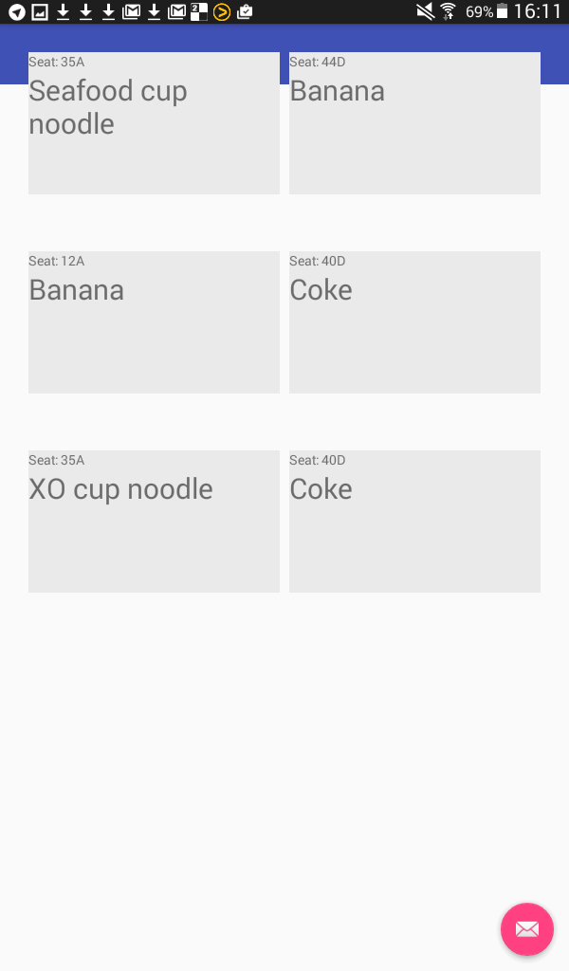
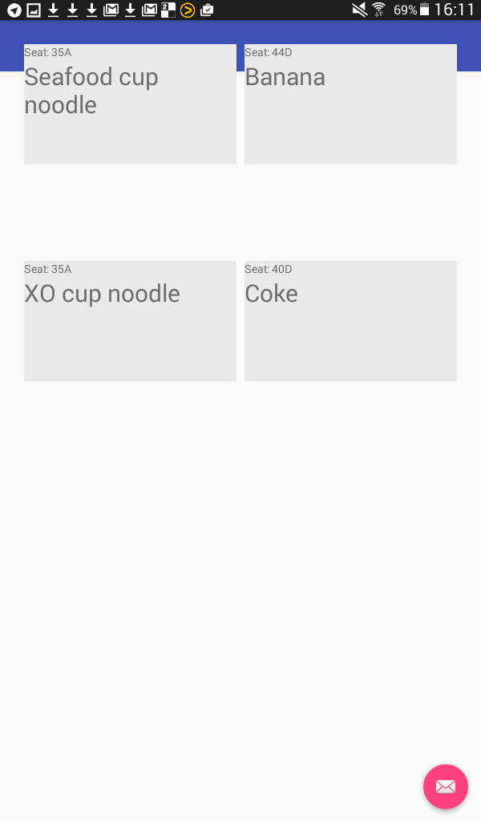
Crew’s view
1. Received order from customers
2. After serving two customers

